Slide 1
EDH – Driving Towards Global Sports Information Leadership through Innovation
June 2009
Innovation &Entrepreneurship, Group 3 Project
UCT Graduate School of Business, Cape Town
MBA Full Time 2009

Slide 2
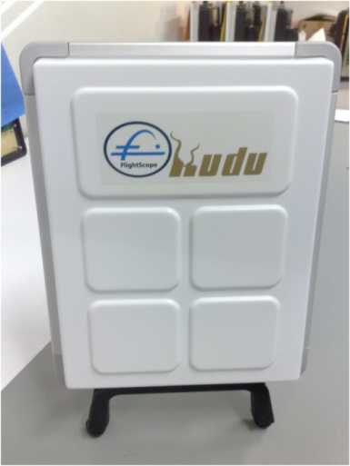
Contents
EDH Background and Products
Innovation & Entrepreneurship Process:
Idea Generation
Project Selection
Production Process
Commercialization Process
Suggestions

Slide 3
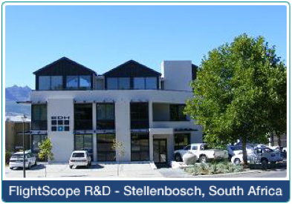
EDH Background EDH developed 3D radar tracking systems for military, industrial and sports uses
Founded in 1989 by Henri Johnson as Electronic Development House (EDH)
Production operations headquartered in Stellenbosch, South Africa with marketing and sales based in Orlando, Florida USA
Core expertise is the design and development of 3D radar tracking systems for military, industrial and sports uses
In 1992 launched its first ballistic measurement radar based on phased array technology
In 1996 first moved into the sports sector with cricket bowling speed tracker ‘EDH Speedster’

Slide 4
EDH Timeline of Key Events
Venture Capital
Product Launch
Here Be Dragons Venture Capital (HBD) becomes a partner in EDH’s world-wide expansion with a 45% equity stake
Speedball® System for cricket introduced
Capital
Award
Initial outside capital injection from Industrial Development Corporation (IDC)
FlightScope® is awarded the GolfTest USA Seal of Excellence
1995
2001
2002
2005
2006
2007
2008
1st Demo
Award
Global Network
The first public demonstration of FlightScope® is conducted in Ponte Vedra Beach, Florida
EDH wins the Top Technology 100 Minister’s Award for excellence
Endeavour Global selects EDH to become part of its world-wide network of high-impact entrepreneurs

Slide 5
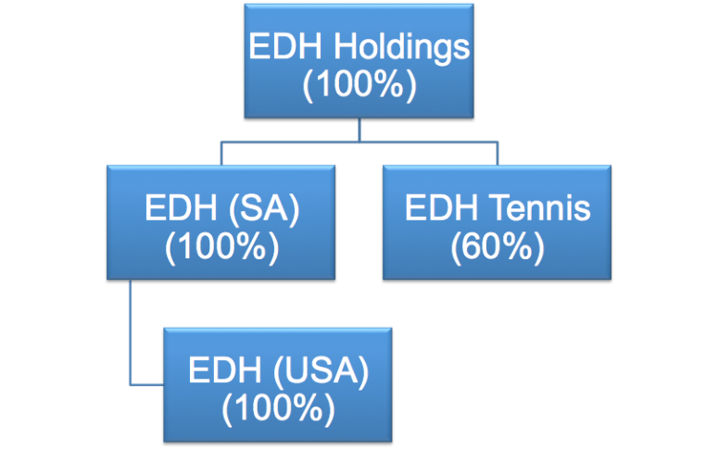
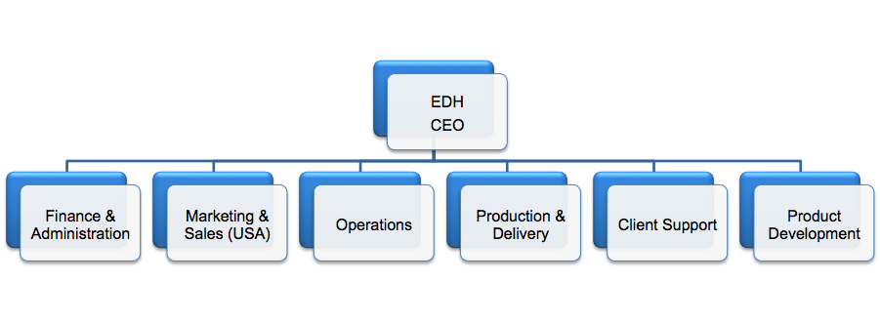
EDH Organisational Charts
EDH group structure
EDH Organisational Structure
Notes:
EDH Tennis entered into a partnership with Polish firm JARGO to provide expanded tennis services.

Slide 6
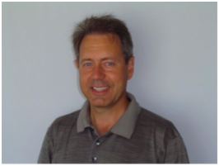
Henri Johnson: Driving the Innovative Vision EDH is led by its charismatic founder and CEO Henri Johnson
The Man behind the Innovative Drive
Electronic engineer by training with a focus on sonar and radar technology
Developed radar technology for military use, to measure velocity and trajectory of projectiles while in flight
Through investigating the commercial use of military application, discovered that similar technology could be used to measure the speed of sports balls
Remains the innovative force behind EDH development, by constantly seeking opportunities and ideas to translate into innovations
EDH Founder and CEO, Henri Johnson
‘If it is possible, we can develop it’ – Henri Johnson
Notes:
Henri Johnson moved to Orlando, Florida in 2008 to establish EDH’s sales and marketing operations.

Slide 7
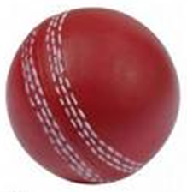
EDH Sports Products EDH to date serves 3 sports: Golf, Tennis and Cricket
Golf
Cricket
Tennis
FlightScope®, a 3D radar tracker that is able to follow the trajectory of golf balls, providing information on speed, direction and angle of the ball as well as other critical data to the golfer
Previously know as Speedstick® and SpeedBall®, FlightScope's ® cricket application measures the speed at which the ball leaves the bowler's hand
EDH Tennis has merged with European firm JAGRO to offer a comprehensive tournament adjudicating package, including an umpire scoring system and service speed tracking device
Notes:
EDH also has the FlightScope Putting Eagle® that is expected to come to marker later this year. For the purpose of this presentation, we will focus on the FlightScope® product line to analyze the innovation process at EDH

Slide 8
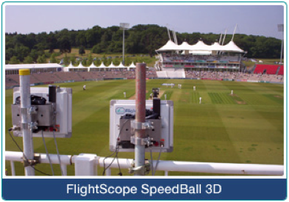
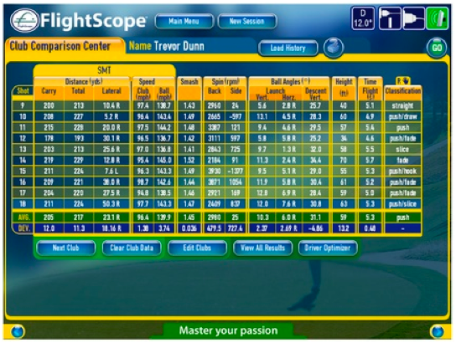
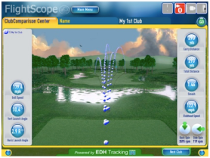
FlightScope®: The Cornerstone of EDH Innovation
Cornerstones
The Product
World’s first 3D Doppler tracking golf radar
Used for golf coaching, swing analysis and club fitting
Uses motion tracking device with radar technology and advanced industrial electronics
Measures: real time ball and club tracking; ball speed; launch angles; sidespin; backspin etc
Conducts golf swing analysis by measuring golf club variables: club head speed; club vertical attack angle; club horizontal attack angle; club angle
Notes:
FlightScope® Kudu is the latest version of FlightScope’s® product line.

Slide 9
Innovation Framework This model has been applied to EDH in order to encompass the different aspects of their entrepreneurial and innovation processes.
Idea Generation Process
Idea Selection Process
« How are ideas generated? »
« How do we select the right idea? »
Innovation Process
« How do we enable the process?»
« How do we bring it to the market?»
« How do we produce it?»
Commercialisation Process
Production Process
“Innovation distinguishes between a leader and a follower.”
Steve Jobs
Notes:
Note: this model has been developed by Group 3 from an assortment of Innovation and Entrepreneurship readings and teachings.

Slide 10
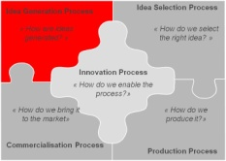
Idea Generation: Henri Johnson is EHD’s primary idea originator
Objective of Analysis
Key Note
« How are ideas generated? »
« Henri is constantly listening, reading and seeking out ideas. This allows him to see opportunities that otherwise would be passed up and to translate these ideas into products, even when the technology in not there yet » Tom Johnson
Details of Analysis
A top-down process: Henri Johnson formulates and communicates innovative visions
Ideas to iterations, engineering team then captures vision and works on making it a reality
Typically a 12-24 month timeframe for project from concept to product production
New ideas motivated by the challenge of creating what others think is impossible, or can not produce
Able to distinguish the difference between a technical product and a commercial product
HBD has been very involved and actively helping out with process, adding outsider perspective
Focused on finding innovative applications and diverse uses for existing technology
Notes:
The bulk of idea generation rests on the shoulders of Founder and CEO Henri Johnson. Thus the idea generation process of flowing ideas down from the top is a natural result of this responsibility. The lack of outside shareholders in early life of EDH helped spurn idea generation as the management team had complete control over initiatives and innovation process and did not have to worry about investor pressure for fast return on investment. The partnership with HBD and their non executive board members has helped to focus the idea generation process and promote a focus of taking decisions which will ultimately increase the bottom line..

Slide 11
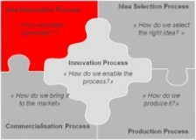
Idea Generation Analysis The concentrated idea generation process has a proven track record yet it has potential to become unsustainable with future growth
Entrepreneurial culture
In touch with current technology trends
Henri Johnson is a natural and persistent innovator
Proven ability to identify new applications for existing technology
Dependent on single individual for majority, if not all entrepreneurial thought
Primarily top-down generation
Strength
Weaknesses
Empower the Engineering team to be a part of the process at the conceptual phase
Go to the market for ideas via focus groups, market research, etc
Idea generation is very centralized
Possibility that competition innovates with greater speed and gains first to new market advantage
Possibility of larger competitors entering the market
Opportunity
Threats
Notes:
In general, this area seems to have strengths that double as weaknesses. It’s excellent that HJ is such a natural born inventor, but potentially dangerous if he is the sole bearer of the idea generation burden. In addition, we see opportunities to listen to the market and get feedback from customers, in order to improve existing products and get more ideas for new ones.

Slide 12
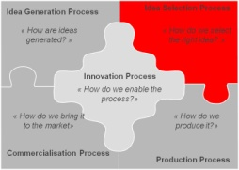
Idea Selection Process EDH’s project selection process enables the company to focus their innovative vision on value creation
Objective of Analysis
Key Note
« How do we select the right idea? »
« We have to find a balance between what is interesting and what can make money. That is the key to deciding which project direction we should go » Jannie de Wet – EDH, CFO
Details of Analysis
Projects are analyzed and initially recommended through a three-member committee of CEO Henri Johnson, COO Tom Johnson and CFO Jannie de Wet
Selection is based on ability to add value to organisation, gut instinct of committee, current resource constraint analysis and limited market research data
After committee selection, potential project go before the board of directors for final approval
Due to a desire to allocate scarce resources wisely, the board bases project decisions on core strategy alignment and cost/revenue implications
Selection criteria includes an examination of the size of the market; break-even analysis
Due to limited resources and current capacity constraints, the selection process must be strategically focused with revenue and value generation in mind
Notes:
The idea selection team consists of CEO, Henri Johnson, Director of Business Development and Operations, Tom Johnson, and Chief Financial Officer Jannie de Wet. They together discuss and decide on which new ideas to foster and spend money on and which idea’s and/or current projects' to cull or put on hold.
Although projects are typically decided annually, there are exceptions to this rule. The upcoming tennis project was too exciting to delay and the board was approached for extra funding to develop the new product as soon as possible.

Slide 13
Project Selection Analysis Analysis is essential to assess the expected rewards versus potential project risk
Diversity of expertise and backgrounds on selection committee
Proven results give credibility to analysis and ‘gut feelings’ decision making
Input of HBD non executive board members give added perspective and independent thought to process
Concurrent projects diluting focus
Absence of rigorous project discontinuation process for non value adding activities
Lack of an integrated market feedback process to evaluate success and identify areas of improvement
Strength
Weaknesses
Include sales/marketing representation in decision making, gathering a closer view of the market
Include market research and/or focus group feedback in decisions
Spin-off part of the company for high-risk projects
May be missing key ideas without fully utilizing own engineers, sales and marketing teams for idea creation and input to selection process
Risk of wasting valuable resources on projects not discontinued in timely manner
Opportunity
Threats
Notes:
Overall, we feel that this is an area where there are opportunities to expand the field of vision by including other voices in the process. We certainly don’t mean to clutter the process by including too many voices; only that, on occasion, it might be fruitful to consult the sales/marketing team in order to understand their perception of needs in the marketplace.

Slide 14
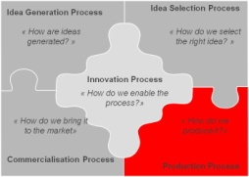
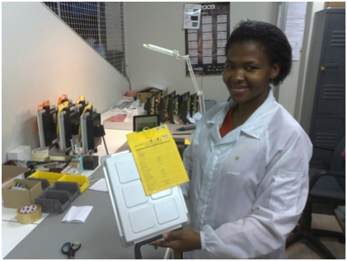
Production Process Low costs in South Africa allow EDH to produce competitively priced products
Objective of Analysis
Key Notes
« How do we produce it? »
« We are very innovative (In South Africa), With lower costs of local production, customers can get much more innovative products for the same price range than those from overseas »
Amos Brummer – EDH Senior Engineer
Details of Analysis
All production occurs at the Stellenbosch facility
Considered moving production and operations to the US, but decided to remain in South Africa for cost implications
Source components from both South African and international suppliers
Increasingly utilizing component sub assemblies to reduce production time
Stellenbosch production facility

Slide 15
Production Process Analysis Current production process is struggling to keep up with present market demands
In-house assembly allows for maximum quality control
Low inventory costs add substantial value to bottom line
Flexibility and manoeuvrability of production allows for easy adaption to customer specified needs
Limited inventory capacity results in vulnerability to delivery delays
Not scalable to produce large orders quickly
Poor reliability from some overseas suppliers
Large number of suppliers increase chances of delay or bottle necks
Strength
Weaknesses
Utilise more sub-assemblies for components to maximize productivity
Rethink entire production operation to optimize facility and cater to current and future demand
Maximize cash flow by concluding sales transactions as fast as possible
Production facilities are currently at capacity and this is causing current and possibly future delivery delays
Inability to respond quickly to increased order demand could lead customers to seek out competitors
Opportunity
Threats

Slide 16
Flight Scope® Current Production Volumes Sales from increased market exposure are outpacing current production capacity and delaying the delivery of products
EDH is currently producing approx. 20 units per week
Market demand is much higher (100% Growth YTD, 12% forecasted)
EDH is running out of production capacity
Note: Sales growth in 2009 includes a price increase

Slide 17
Production Outsourcing Strategy In order to overcome production constraints, the company has several possible solutions
Outsourcing possibilities include:
Full Product Production vs. Parts Production
Local vs. Global
EDH could consider to outsource current production to local electronics manufacturers
Full Product
RISK CHANGES?
Production Outsourcing Scale
Parts
Local
Global
Production Outsourcing Location

Slide 18
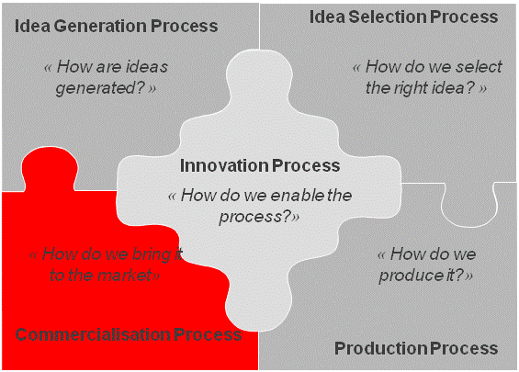
Commercialization I of II: Bringing Innovation to the Market EDH is currently using four distribution channels to bring FlightScope® to market
Objective of Analysis
Key Note
« How do we bring it to the market? »
« The sheer power of the personal presence, of getting out and demonstrating the product can not be under estimated »
Tom Johnson – EDH Chief Operations Officer
Details of Analysis
Building the FlightScope® brand is the number one promotion strategy
Utilizing four main channels to bring FlightScope® to market
Internet - biggest potential growth channel as brand awareness increases
Independent direct sales force – 3rd party agents who sell FlightScope® on behalf of EDH
Key Accounts – Have established direct relationships with key golf club manufacturers like Taylor Made, Calloway and Ping to expand brand recognition
Distributors and independent resellers – utilised in less established markets outside the US and Europe
Notes:
EDH is using a wide variety of options to continue to build FlightScope® brand recognition and thus improve market penetration. They see internet sales as the future channel with the most potential, and are building this core capability to be developed and exploited. The independent direct sales force tends to be a difficult, but necessary channel as reliable agents are tough to find. Also, distributors are a key component to take advantage of smaller, less developed markets. These resellers share the responsibility and risk of sales and allow market penetration into less developed or more difficult markets such as Japan.
A key question for EDH would be to assess what is the likely size of the market, and then to identify and define all possible market opportunities. For instance, not only the obvious customers like golf courses and professionals, but also less obvious potential customers like major sporting goods stores or party event planning organizations that could represent hidden opportunities. As so many options are present, EDH must focus their efforts on a defined market segment, so as not to dilute efforts and possibly miss key sales opportunities.

Slide 19
Commercialization II of II EDH is using cost effective and efficient marketing tools and have moved their sales headquarters to the United States
Details of Analysis
Moved sales and marketing operations to Orlando, Florida in 2008 to be at the core of the US market
The relocation of their sales and marketing effort has resulted in a tripling of sales so far
To date, appointed two public relations representatives responsible for promoting FlightScope® in UK and US
Using a limited, but cost effective portfolio of marketing tools including print media, event sponsorship and trade shows to build brand awareness
“The most important thing in any business is sales. We can control costs, can control other aspects, but must have sales to survive”
Jannie de Wet – EDH, Chief Financial Officer

Slide 20
Commercialization Process Analysis Current process must clearly differentiate FlightScope® from competitors maximize marketing opportunities
Lower selling price is a major competitive advantage
US based sales operation puts EDH at centre of target market
Efforts resulting in increased FlightScope® brand recognition
Variety of marketing options utilized like print and event sponsorships to expand audience
Limited data collection on target market and effectiveness of promotion strategy
Reliance on 3rd party distributors causes some unpredictability and areas of concern
Limited market penetration
Limited purchasing options
Strength
Weaknesses
Fully develop online internet sales with financing options
Provide formal user feedback option for website
Harness well-known South African golfers for key endorsements to add credibility to brand
Exchange rate fluctuations
Sales outpacing production capabilities
Low cost may lead some customers to believe the product is inferior to more expensive competitor model
Not being able to meet customer expectations
Opportunity
Threats
Notes:
EDH has to continue to be mindful of exchange rate fluctuations. For example, the depreciation of the US Dollar to South African Rand exchange rate from R10 to $1 in January down to R8 to $1 in June translated into a R2 million decrease in revenue. If Rand continues to strengthen against the dollar for the foreseeable future, that could pose a major threat to profit margins.
The high cost of the product needs to be mitigated by making payment options available to less capital strong buyers as the US is a market very used to such payments facilities.
Currently, FlightScope® has only one primary competitor, TrackMan™ produced by Danish firm ISG A/S, which has very similar technology but a much higher price positioning. EDH has a major competitive advantage with the low cost of production in South Africa and can take more opportunities to highlight price difference. In a difficult economic climate, this price differential can be further maximized.
FlightScope’s® position of being first to market with radar technology gives it a competitive advantage in credibility. FlightScope® received widespread publicity by being featured at the European Open in June 2009. EDH can capitalize on this and similar exposure to boost sales. Also, a key endorsement from a well know South African golfer, like Ernie Els, Retief Goosen, Trevor Immelman or others would give substantial credibility to the product and create a ‘Proudly South African’ styled theme around its quality. This would also help dispel any possible doubts on the ability of a product developed in South Africa as opposed to well thought of Denmark, where their competitors are based.

Slide 21
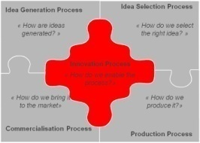
Innovation Process Analysis: Summary EDH is in a position to build on past success and to move closer to its aspiration of becoming the global sport information supplier
Innovative firm with inspirational leadership
Strong cash flow from solid sales and low production costs
First to market and best in class advantage
High margin market segment
HBD gives back 7% of EDH equity this year as agreed performance targets where met
Concentration of intellectual capital with a few individuals
Limited production capacity could inhibit growth
Considered a luxury product, not yet a necessity
Small, South African based operations could impede international growth
Strength
Weaknesses
Offer a high-end, “platinum” version of FlightScope® that is priced nearer competition’s price level
Expand into other sports such as baseball and table tennis
Separate FlightScope’s ® golf operations into own entity to concentrate efforts on most promising market
Limited capital to protect intellectual property patents from intrusion
Majority of resources behind the FlightScope® brand results in lack of revenue diversification
Exchange rate fluctuation risks
Opportunity
Threats
Notes:
Currently, FlightScope® has only one primary competitor, TrackMan™ produced by Danish firm ISG A/S, which has very similar technology but a much higher price positioning. EDH has a major competitive advantage with the low cost of production in South Africa and can take more opportunities to highlight price difference. In a difficult economic climate, this price differential can be further maximized. FlightScope’s® position of being first to market with radar technology gives it a competitive advantage in credibility.

Slide 22
Key Suggestions I of II
Product
Consider separating FlightScope® golf division from rest of company, so as to focus resources and entrepreneurial attention on areas with future potential and appoint a sales focused CEO to drive FlightScope sales and market penetration
1
Consider separating FlightScope’s ® golf effort from other sports offering to focus resources this high potential area
1
Offer fully equipped FlightScope premium package option with included accessories at price point comparable to TrackMan™
2
Continue to upgrade website with new features and graphics to match quality level of tennis partners JAGRO and surpass professionalism of TrackMan™ site
3
Leverage new sales/marketing location to further image as a global leading brand and deter larger competitors from entering the market
4
Production
Prepare production capabilities for increased volume of sales as a result of increased promotional efforts – evaluate potential outsourcing, sub-outsources or new facilities options
5

Slide 23
Key Suggestions II of II
Sales & Distribution
Conduct a thorough competitive analysis of TrackMan™ to refine key differentiating features and focus sales strategy around targeting these differences
6
Consider hiring dedicated in-house US sales force to promote direct sales to customers
7
Explore options to partner with video game producer to feature technology in future developments and games
8
Partner with golf tournaments to ‘bring the FlightScope® experience to the fan’, featuring simulations, long drive contests, etc.
9
Making the use of credit cards and other financing options for purchase, especially to US customers must be an urgent priority
10
Explore other sales opportunities and avenues: prep school and college golf teams, sales to large sports retailers or golf supply store in US market
11

Slide 24
THANK YOU
We would like to extend our sincere thanks to Tom Johnson, Amos Brummer, Jannie de Wet and the entire EDH staff for their generous contributions of time and effort to make this projectas accurate and detailed as possible.

